Slide 1
DFA

Slide 2
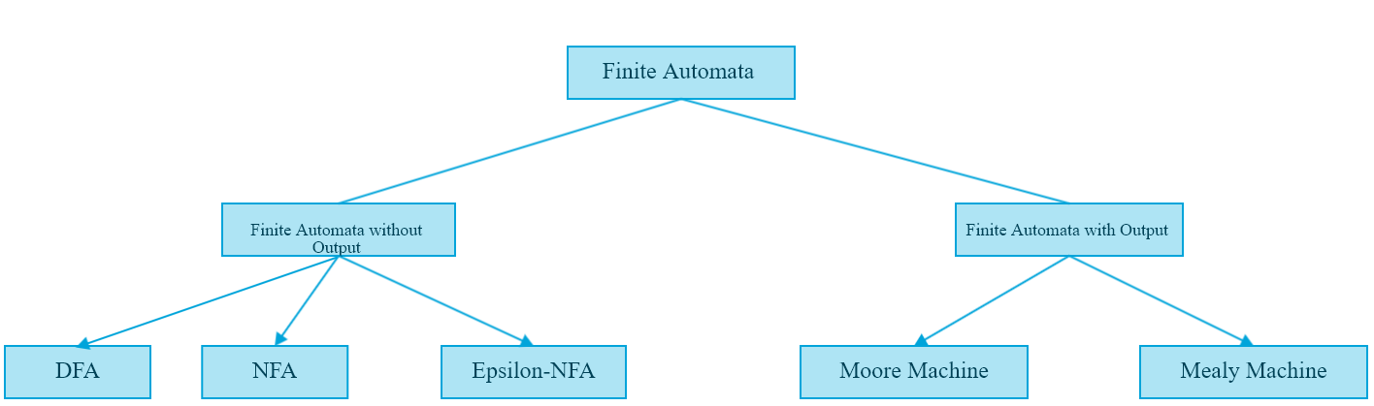
Finite Automata

Slide 3
Deterministic Finite Automata
Formal Definition of DFA
A DFA is a collection of 5-tuples same as we described in the definition of FA.
Q: finite set of states
∑: finite set of the input symbol
q0: initial state
F: final state
δ: Transition function
Transition function can be defined as:
δ: Q x ∑→Q

Slide 4

Example of DFA
DFA with ∑ = {0, 1} accepts all ending with 0.

Slide 5
Practice Questions
Question1-
Construct a DFA, that accepts the set of all strings over {a,b} of length 2.
Question 2-
Construct a DFA, that accepts the set of all strings over {a,b} of length greater than and equal to 2.
OR
Construct a DFA, w€{a,b} and |w|>=2

Slide 6
Question 3-
Construct a DFA, that accepts the set of all strings over {a,b} of length less than and equal to 2.
OR
Construct a DFA, w€{a,b} and |w|<=2.
Question 4-
Construct a Minimal DFA, that accepts the set of all strings over {a,b} of length of each string is even.
OR
Construct a DFA, w€{a,b} and |w|mod 2=0.

Slide 7
Question 5-
Construct a Minimal DFA, that accepts the set of all strings over {a,b} of length of each string is odd.
OR
Construct a DFA, w€{a,b} and |w|mod 2=1.
Question 6-
Construct a DFA, w€{a,b} and |w|mod 3=0.
Question 7-
Construct a DFA, w€{a,b} and |w|mod 3=1.

Slide 8
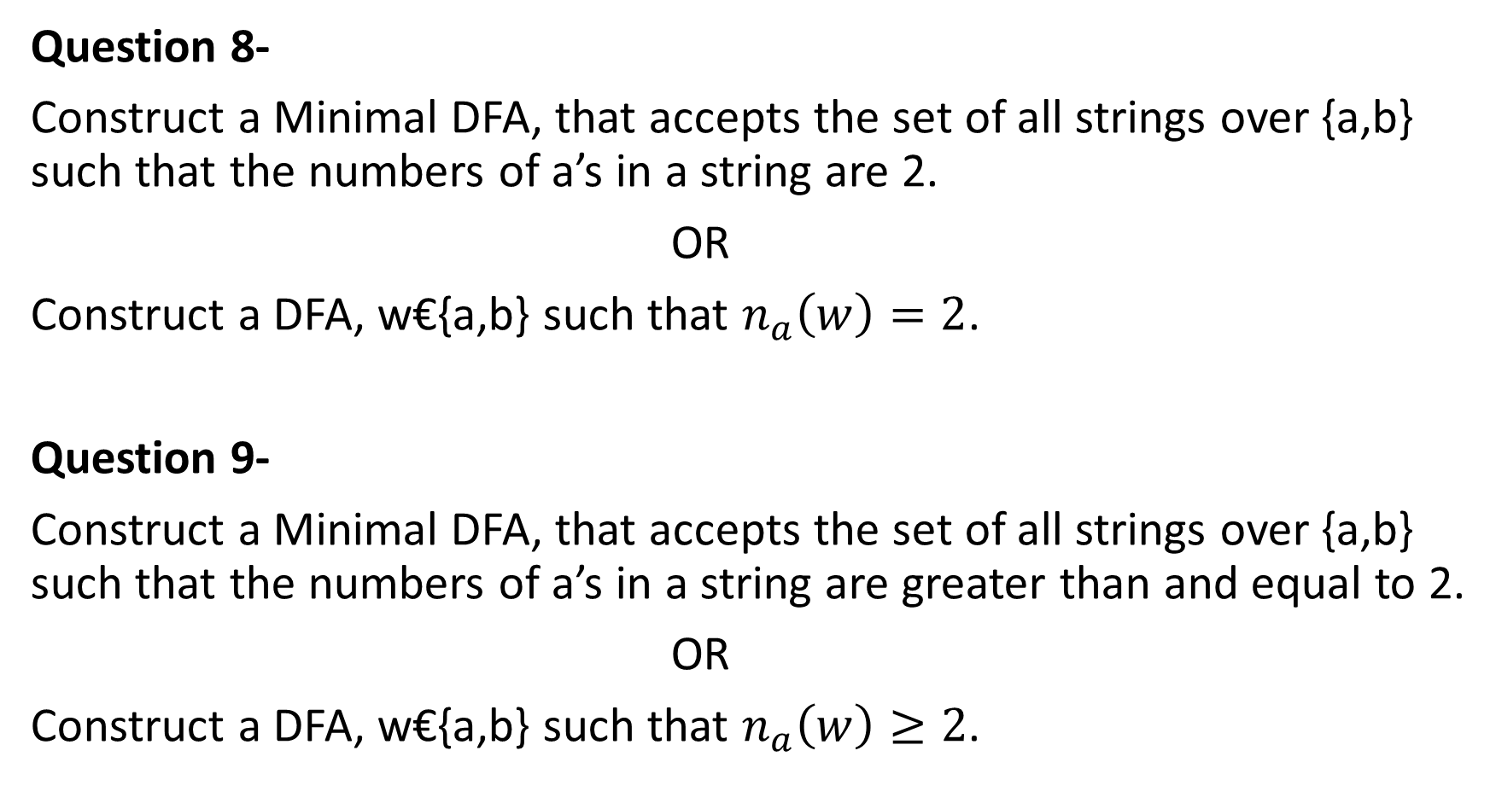
Question 8-
Construct a Minimal DFA, that accepts the set of all strings over {a,b} such that the numbers of a’s in a string are 2.
OR
Construct a DFA, w€{a,b} such that $n_{a}\left(w\right)=2$.
Question 9-
Construct a Minimal DFA, that accepts the set of all strings over {a,b} such that the numbers of a’s in a string are greater than and equal to 2.
OR
Construct a DFA, w€{a,b} such that $n_{a}\left(w\right)≥2$.

Slide 9
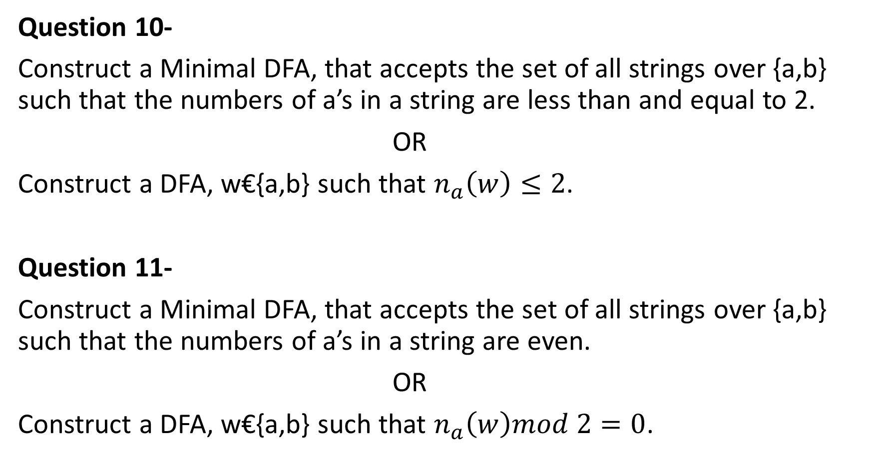
Question 10-
Construct a Minimal DFA, that accepts the set of all strings over {a,b} such that the numbers of a’s in a string are less than and equal to 2.
OR
Construct a DFA, w€{a,b} such that $n_{a}\left(w\right)≤2$.
Question 11-
Construct a Minimal DFA, that accepts the set of all strings over {a,b} such that the numbers of a’s in a string are even.
OR
Construct a DFA, w€{a,b} such that $n_{a}\left(w\right)mod 2=0$.

Slide 10
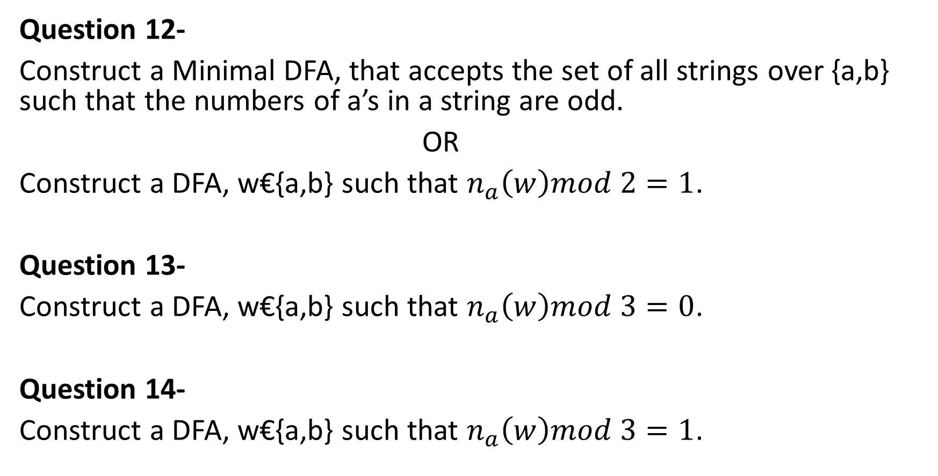
Question 12-
Construct a Minimal DFA, that accepts the set of all strings over {a,b} such that the numbers of a’s in a string are odd.
OR
Construct a DFA, w€{a,b} such that $n_{a}\left(w\right)mod 2=1$.
Question 13-
Construct a DFA, w€{a,b} such that $n_{a}\left(w\right)mod 3=0$.
Question 14-
Construct a DFA, w€{a,b} such that $n_{a}\left(w\right)mod 3=1$.

